Slide 1
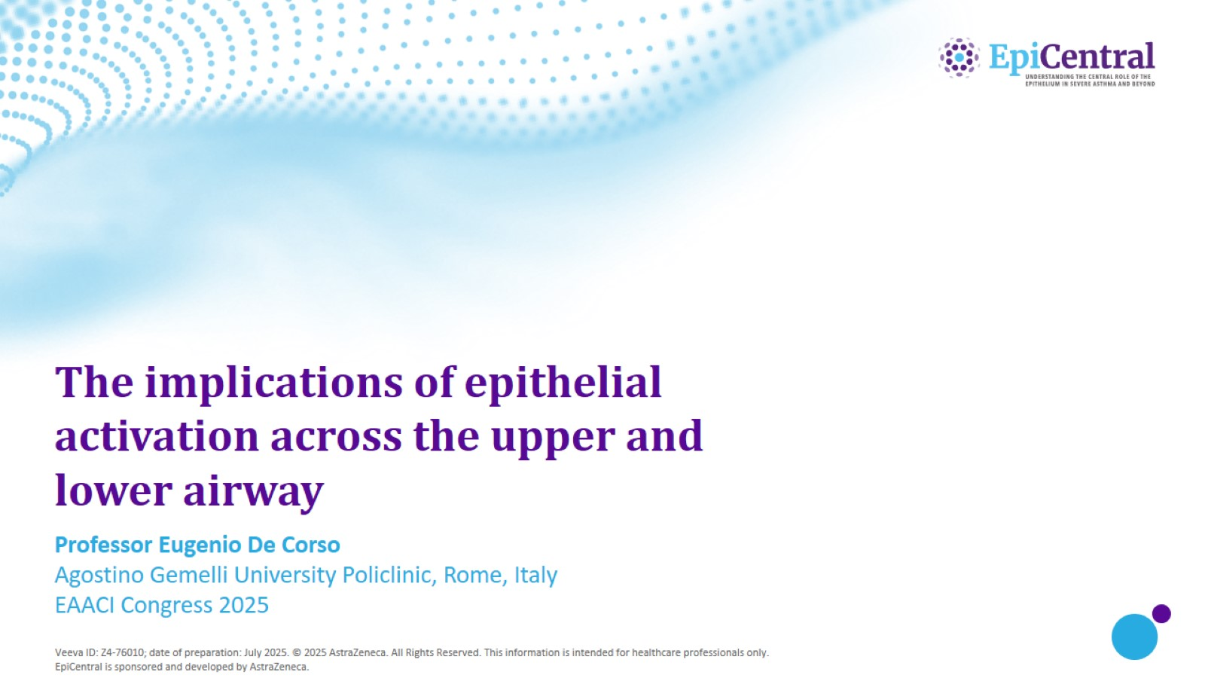
The implications of epithelial activation across the upper and lower airway

Slide 2
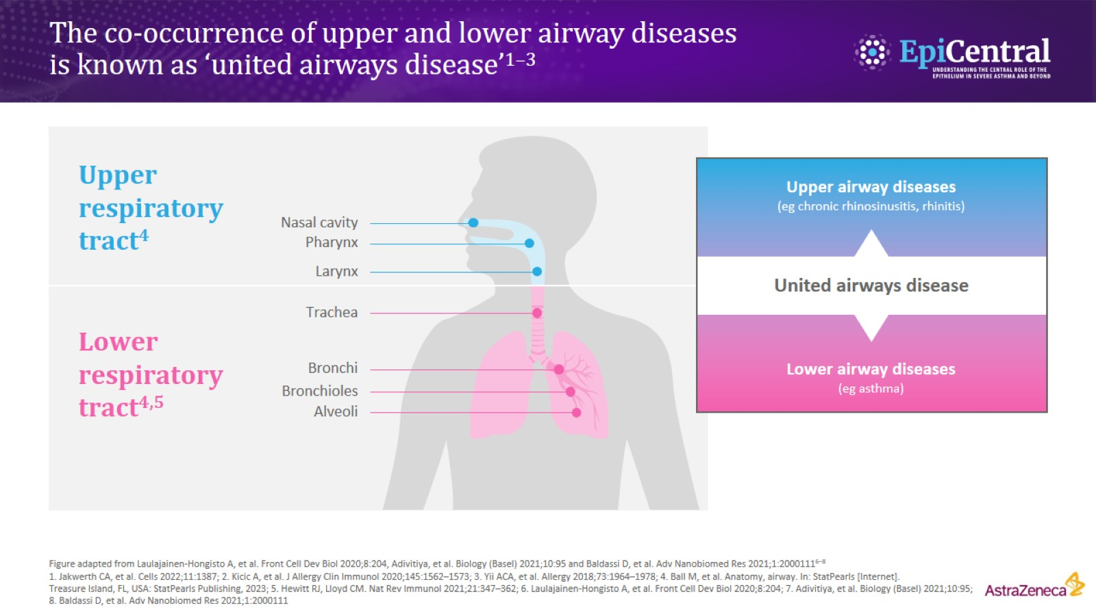
The co-occurrence of upper and lower airway diseases is known as ‘united airways disease’^{1–3}

Slide 3
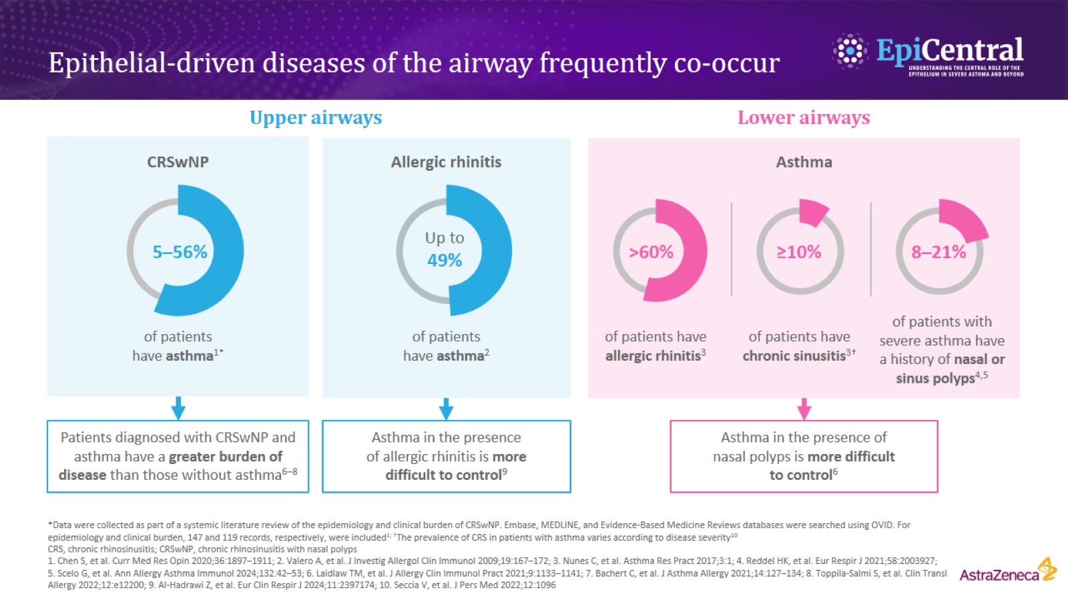
Epithelial-driven diseases of the airway frequently co-occur

Slide 4
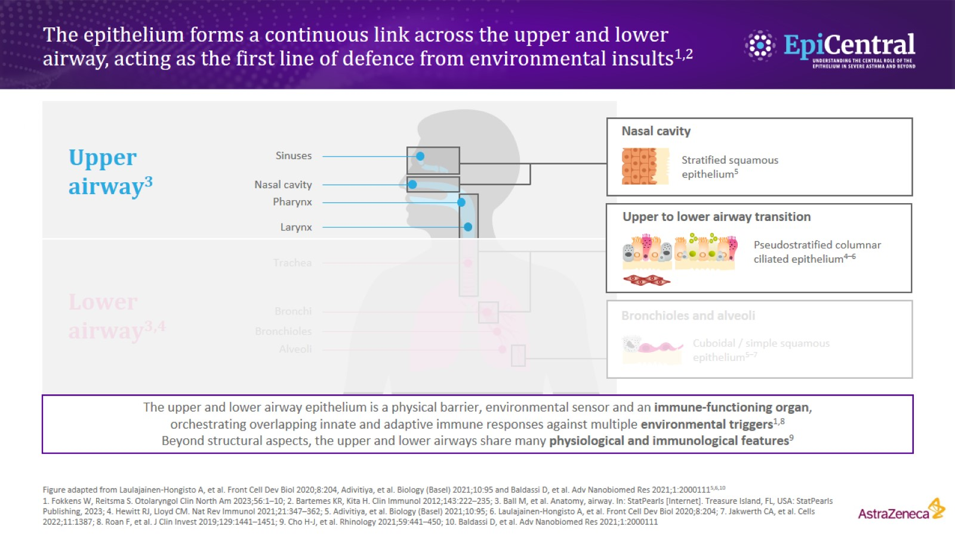
The epithelium forms a continuous link across the upper and lower airway, acting as the first line of defence from environmental insults^{1,2}

Slide 5
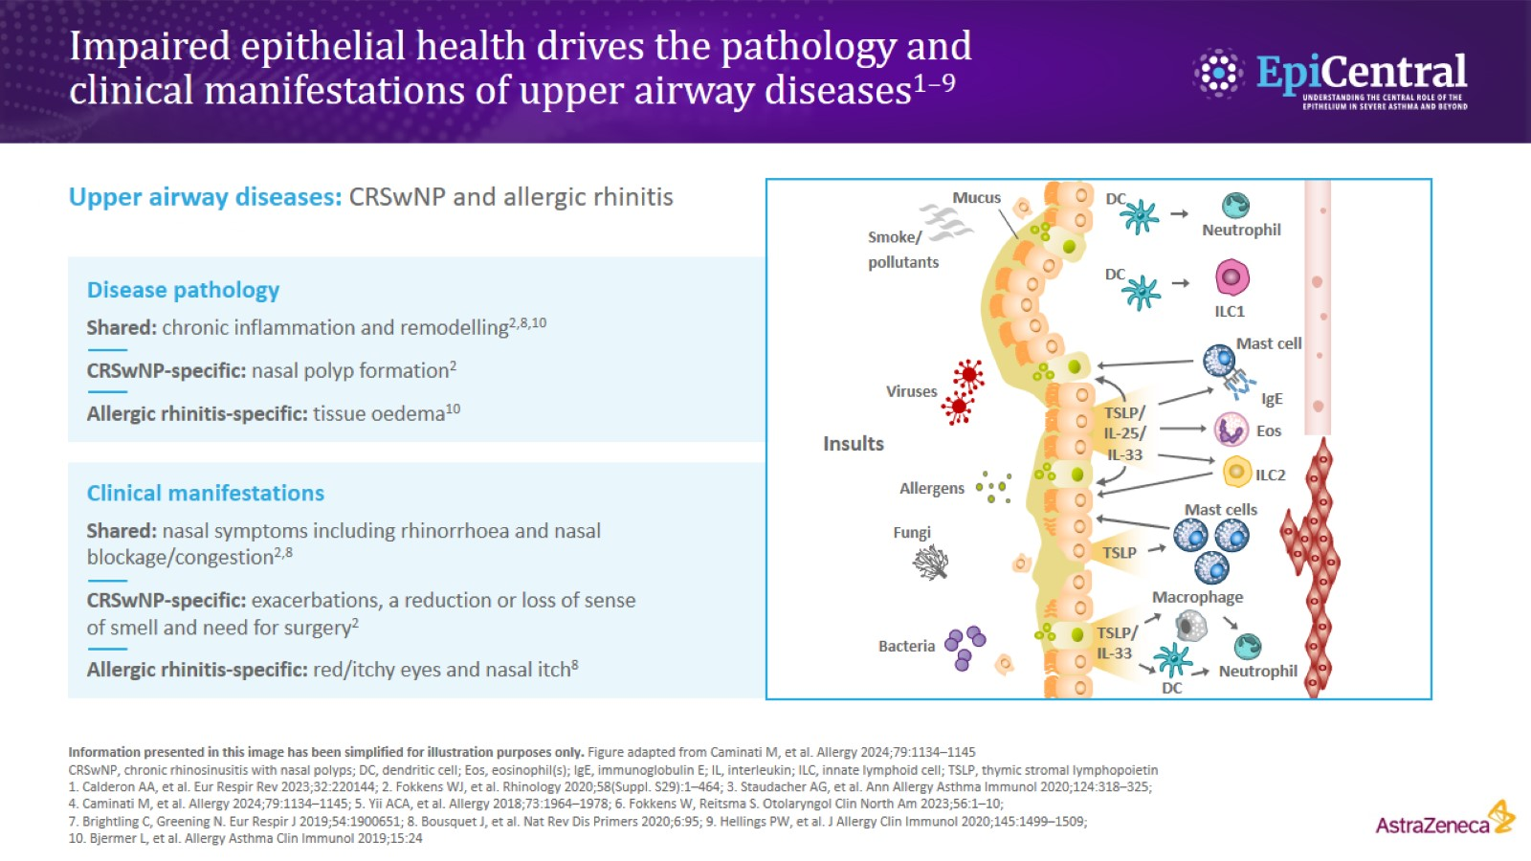
Impaired epithelial health drives the pathology and clinical manifestations of upper airway diseases^{1–9}

Slide 6
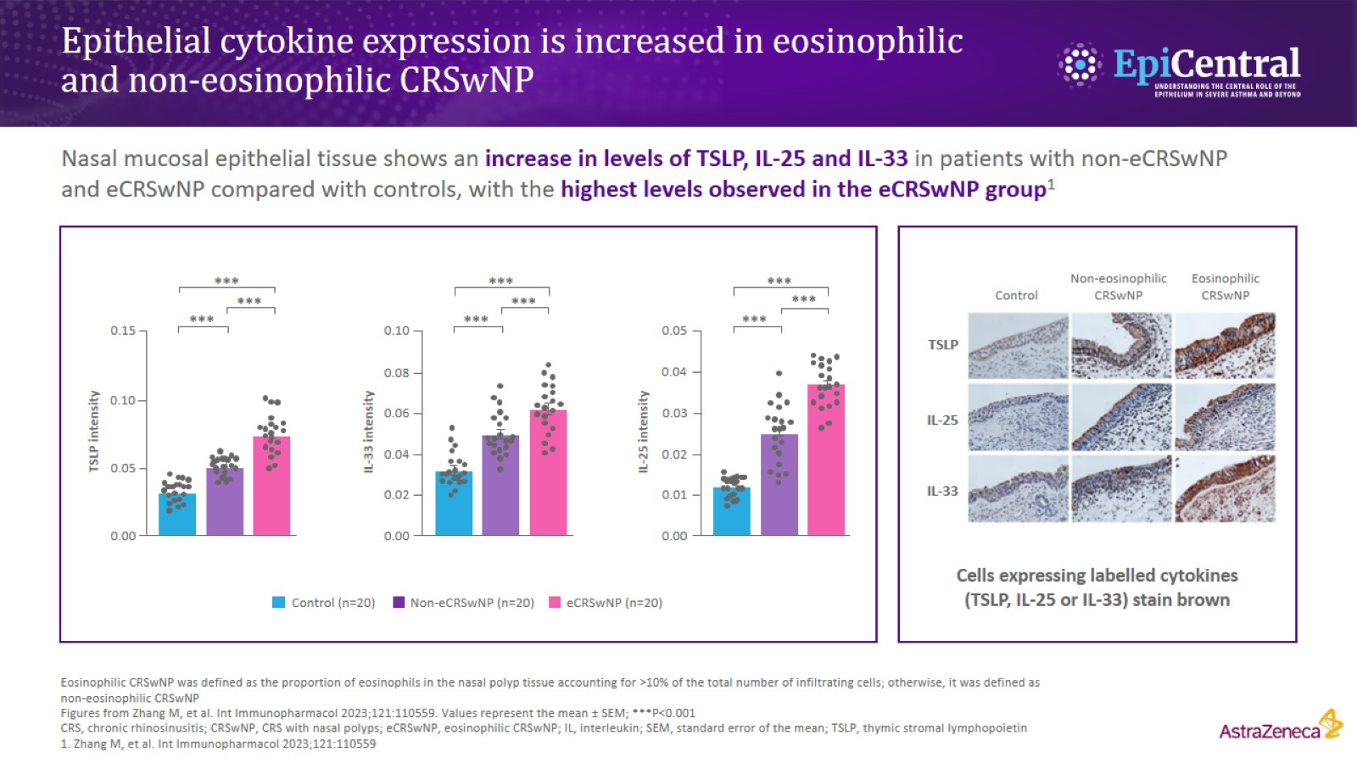
Epithelial cytokine expression is increased in eosinophilic and non‑eosinophilic CRSwNP

Slide 7
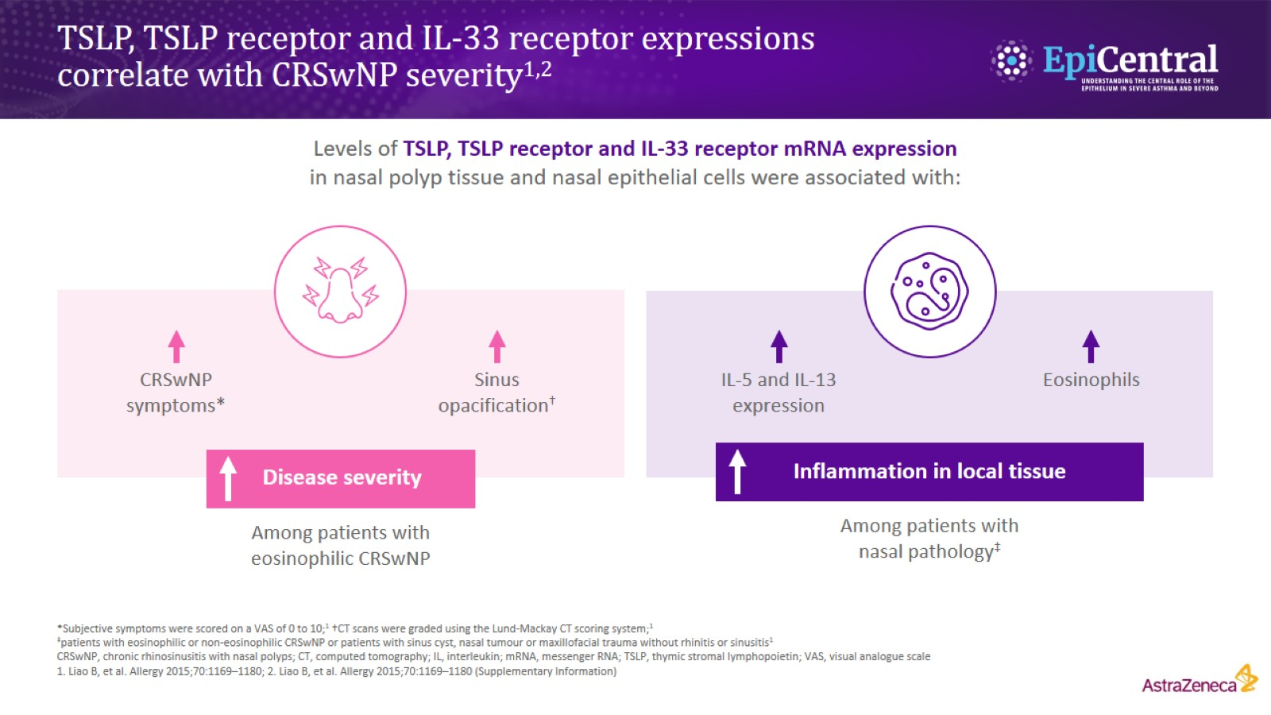
TSLP, TSLP receptor and IL-33 receptor expressions correlate with CRSwNP severity^{1,2}

Slide 8
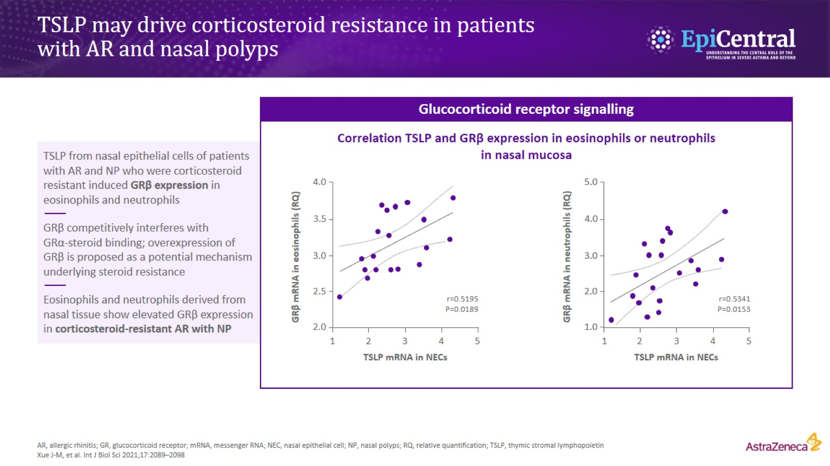
TSLP may drive corticosteroid resistance in patients with AR and nasal polyps

Slide 9
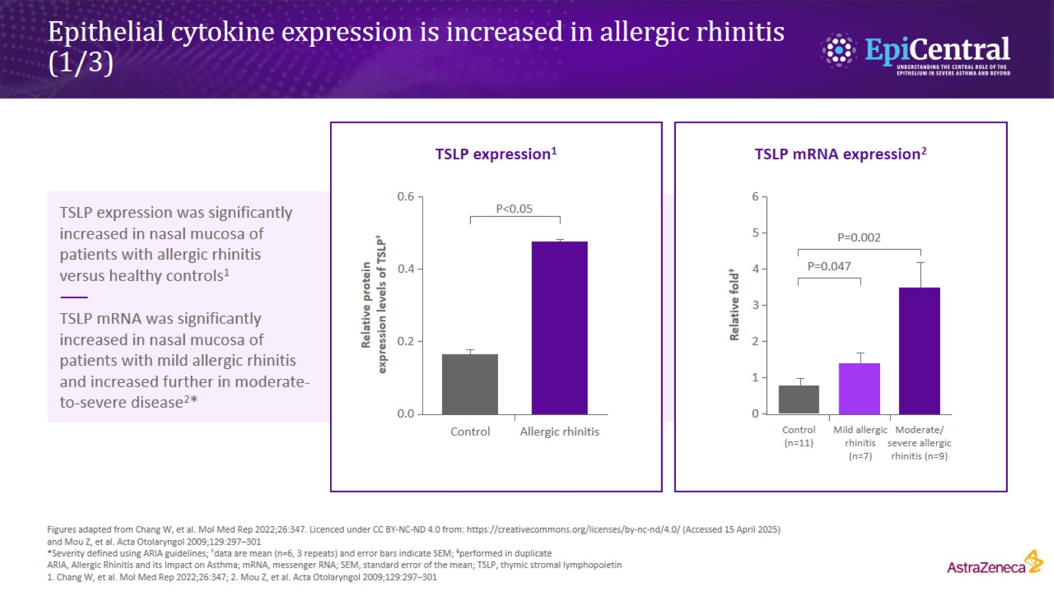
Epithelial cytokine expression is increased in allergic rhinitis (1/3)

Slide 10
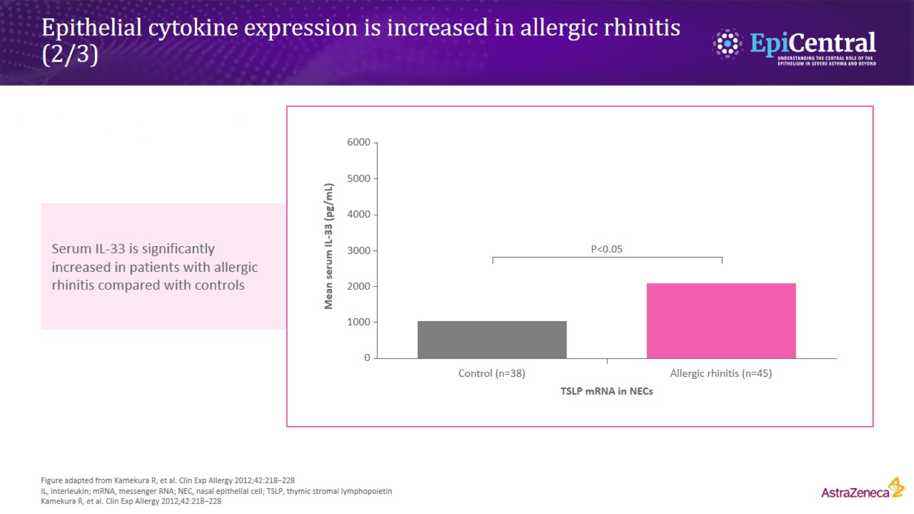
Epithelial cytokine expression is increased in allergic rhinitis (2/3)

Slide 11
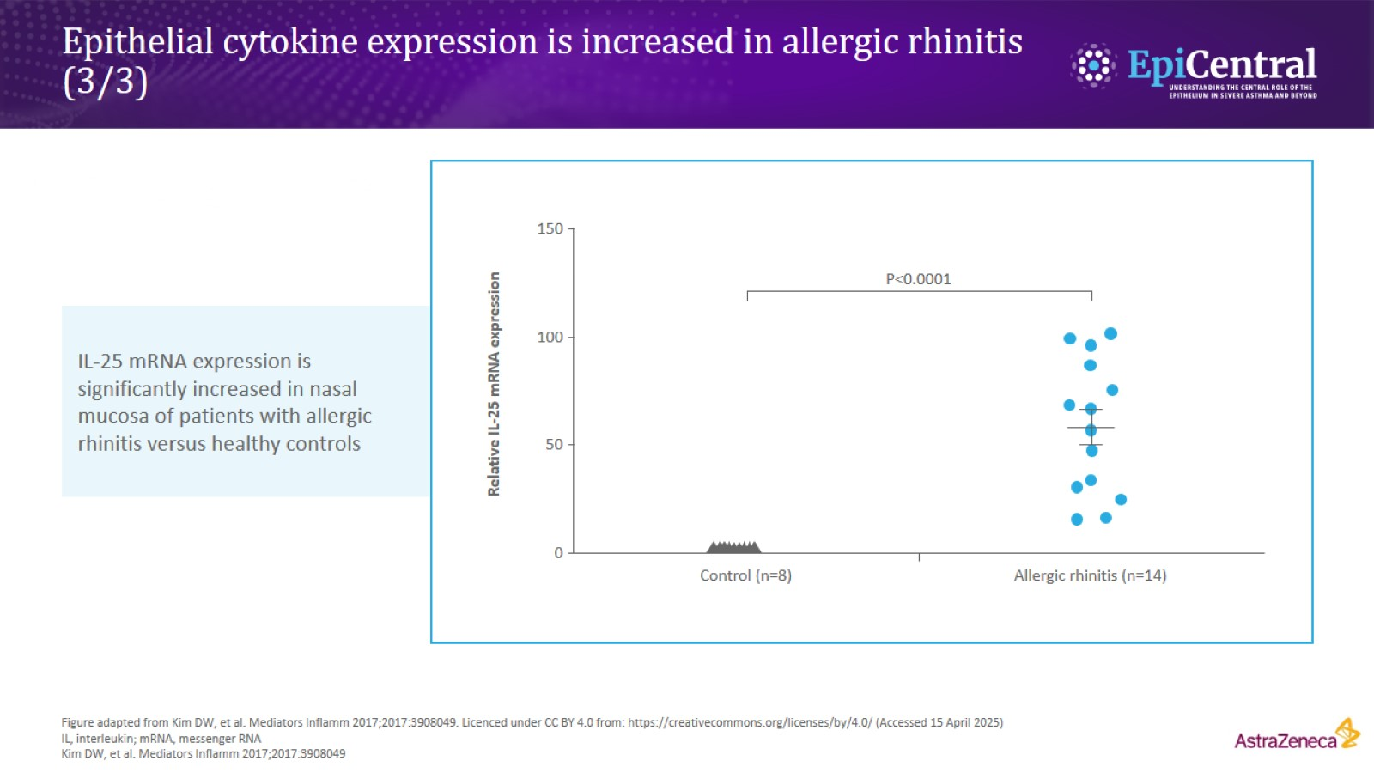
Epithelial cytokine expression is increased in allergic rhinitis (3/3)

Slide 12
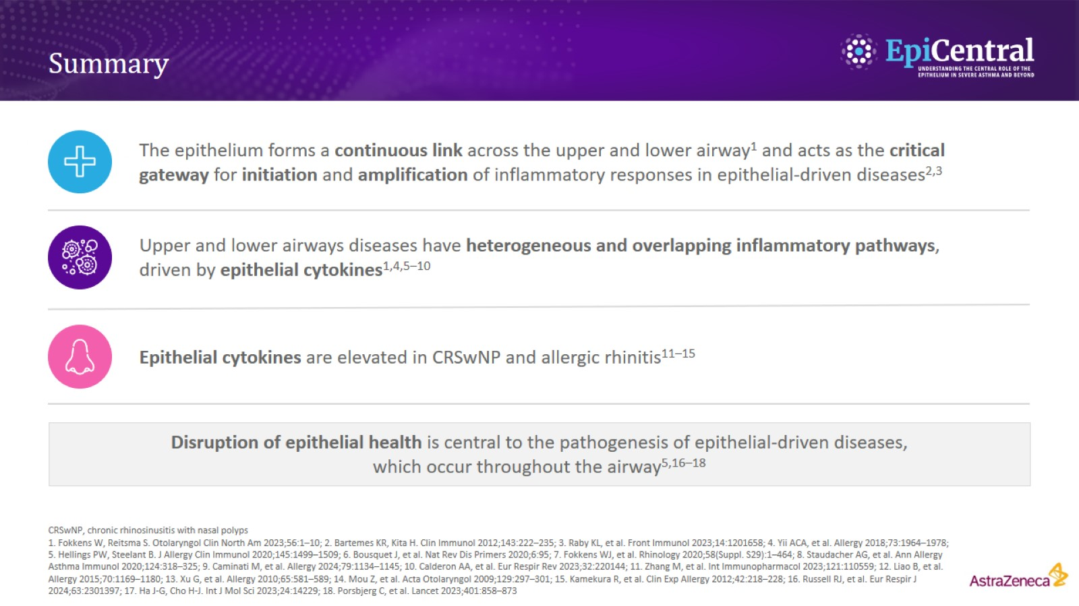
Summary

